Slide 1

Machine Learning Pipeline for L1T PUPPI Candidates
Alex Hayslip, Arghya Das, Michael Ramshaw
Team Name: Classification is in session
Challenge 1: Di-Higgs (HH -> 4b) vs QCD discrimination for trigger systems
Data Extraction, Feature Engineering, classification model development and optimization for Level-1 Trigger Pileup Per Particle Identification.

Slide 2



Problem Statement & Objectives
Context
Level-1 Trigger (L1T) Pileup Per Particle Identification (PUPPI) candidate processing in high-energy particle physics collision events.
Objective
Develop a binary classification model to predict physics signal (HH -> 4B) vs. background noise (is_signal) using reconstructed subatomic particle candidate records as a dataframe parsed together from numerous parquet files in multiple folders.
Key Challenges
Severe class imbalance for signal column, overwhelming amount of dummy/placeholder candidates for particle id, conversation of dataframe into a readable format for classification model

Slide 3




Data Procurement & Ingestion
Pipeline Integration
Parquet Candidate Parsing
Engineered custom robust utility functions read_first_fragment and load_physics_dataset_from_pvc to systematically ingest raw Parquet physics data fragments directly from persistent storage volumes.
Implemented an optimized iterative parser to extract and flatten complex nested candidate arrays from L1T_PUPPIPart Parquet files into structured, tabular DataFrames tailored for high-performance Python analytics.

Slide 4
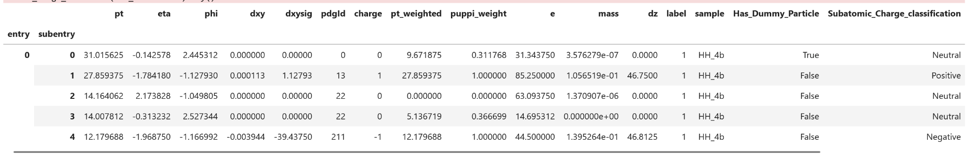
Data Cleaning & Sanitization
Column Scrubbing & Deduplication: Dropped funique_id due to identifier redundancy and error_dz due to uninformative sentinel zeros. Removed 10 identical duplicate records to ensure sample integrity.
Infinite Value Filtering: Identified and purged 3,212 defective rows in the dxysig impact parameter significance column containing positive or negative infinity (±inf).
Categorical Mapping & Masking: Engineered custom subatomic charge categories (positive, negative, neutral) and Is Dummy Variable by applying np.where on pdgid == 0 to explicitly flag dummy/placeholder particles.
Class Imbalance Strategy: Identified and recorded severe target label imbalance in the dataset to inform loss weighting and stratified cross-validation strategies.

Slide 5
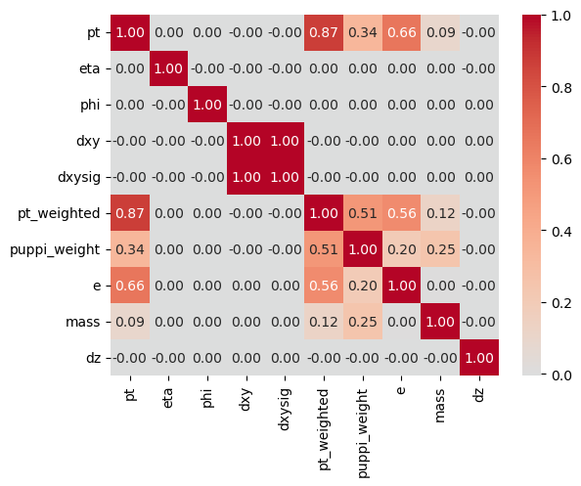




Exploratory Data Analysis
Dummy Variable Overwhelming
EDA revealed that candidate sets contain a heavily dominant proportion of dummy placeholder particles (7,338,212/10,370,440 , 70.6% of data) across collision events.
Neutral Charge Dominance
Subatomic charge distribution is strongly skewed toward neutral particles across both signal and background target classes.
Feature Correlation Analysis
Seaborn correlation heatmaps highlighted strong collinearity between weighted momenta (pt, pt_weighted) and energy (e).

Slide 6








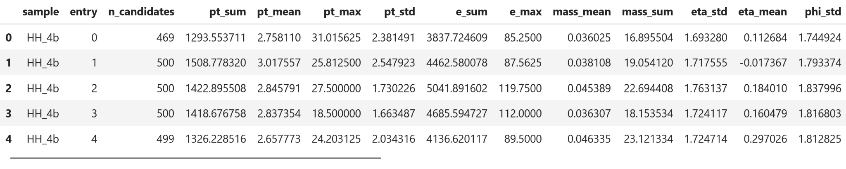
Classification Feature Pipeline
Grouped candidate data by ["sample", "entry"] to construct 23 event-level physics variables across three main clusters:
Charge & PUPPI Features
Noise Indicators
Kinematic Metrics
Total charged candidate count (n_charged), net electric charge, positive/negative counts, and aggregated mean/sum PUPPI isolation weights (puppi_weight).
Sum, mean, max, and standard deviation computed for transverse momentum (pt), total energy (e), invariant mass (mass), and spatial spread (eta, phi).
Transverse/longitudinal displacement significance parameters (dxysig, dz) combined with total dummy count (n_dummy) and dummy fraction (dummy_fraction).

Slide 7
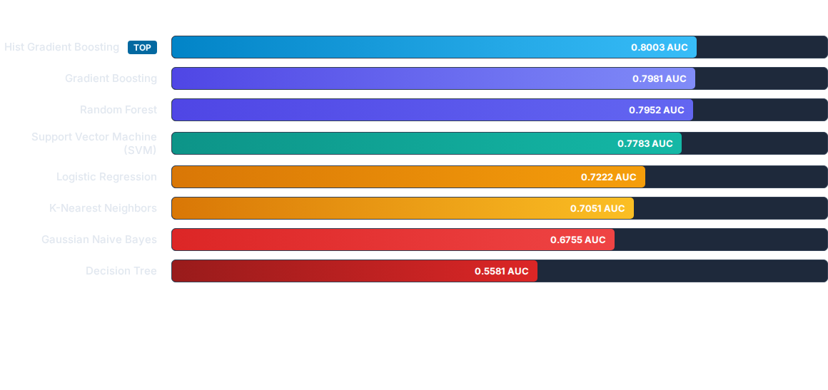
Classifier Benchmarking
Selection Rationale: The Histogram Gradient Boosted model outperformed the logistic regression baseline by ~7.8% AUC points. HistGradientBoostingClassifier was selected as the classification model of choice due a predictive score of (5-fold CV AUC: 0.8003), fast histogram binning speed, and native handling of sparse particle data.

Slide 8


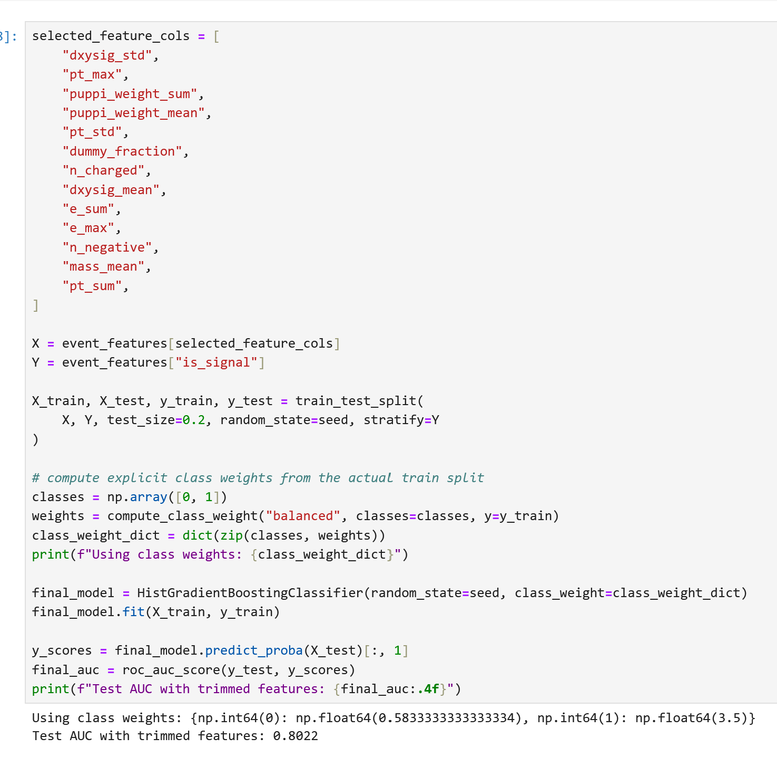


Optimization & Deep Learning
Hyperparameter Search
Ran 50-iteration RandomizedSearchCV on HistGradientBoosting with Stratified 5-Fold CV, tuning learning rate, tree depth, and L2 regularization. The test AUC of 0.7994 performed slightly worse than the baseline HistGradientBoosted Model
Permutation Feature Pruning
Identified top predictors (dxysig_std, pt_max, puppi_weight_sum, dummy_fraction, n_charged) and pruned feature set from 23 down to 13 key predictors. Returned a test AUC score of 0.8022, slightly outperforming the base Histogram Gradient Boosted Classification Model
PyTorch Particle Transformer
Trained sequence-level 3-layer ParticleTransformer (d_model=64, 4 heads, CLS token, padding masks) for 500 epochs, reaching 0.7868 Test AUC directly on raw tensors.

Slide 9
Lessons Learned
Inputs for an ML model are crucial
Changing the data structure from event, subentry format to a groupby format of sample and respective entries improved the AUC performance of the base logistic regression model from 52.8% to 72.2%. From there, I was able to write the classification model pipeline to output the results of eight different models which helped me choose the hist gradient boosted model and optimize its performance.
Gather domain knowledge
I did not have prior knowledge of physics. In order to properly clean and analyze the data, I asked for clarification on what the columns meant as well as what numeric values for each columns would be odd. This influenced my decisions to perform the data cleaning.
Trying New Things is Okay, Even If it Doesn’t Work
Yesterday was the first time I used Pytorch with a transformer architecture to build a classification model. I Trained sequence-level 3-layer ParticleTransformer (d_model=64, 4 heads, CLS token, padding masks) for 500 epochs, reaching 0.7868 Test AUC directly on raw tensors. Even though this model was not selected as the final model, I was able to understand how to build a classification model with the help of PyTorch and transformers.

